Slide 1
Atomic Physics – Wave Particle Duality

Slide 2
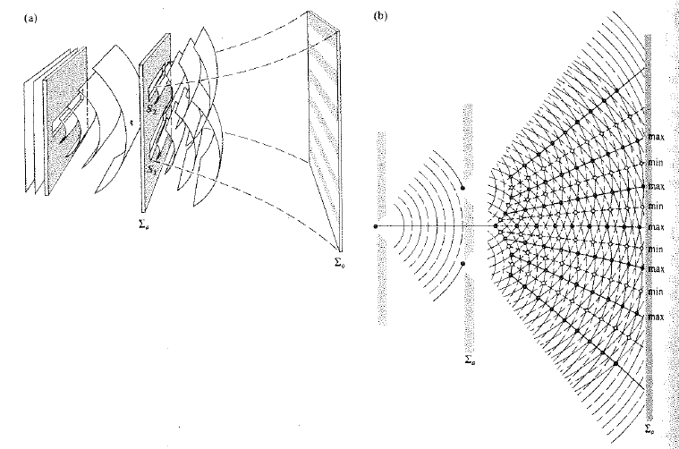
Interference and Diffraction (see Hecht: Optics)
Young’s double slit
experiment

Slide 3
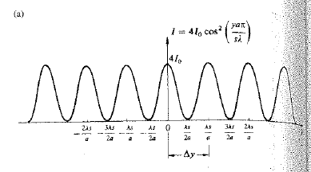
Interference pattern:

Slide 4
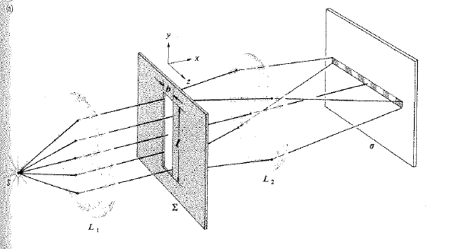
Fine structure due to diffraction and diffraction within single slit:
Diffraction:
But where did the photon
come from within the slit?
Diffraction pattern:
Signal decay to the sides
overlays interference pattern.

Slide 5
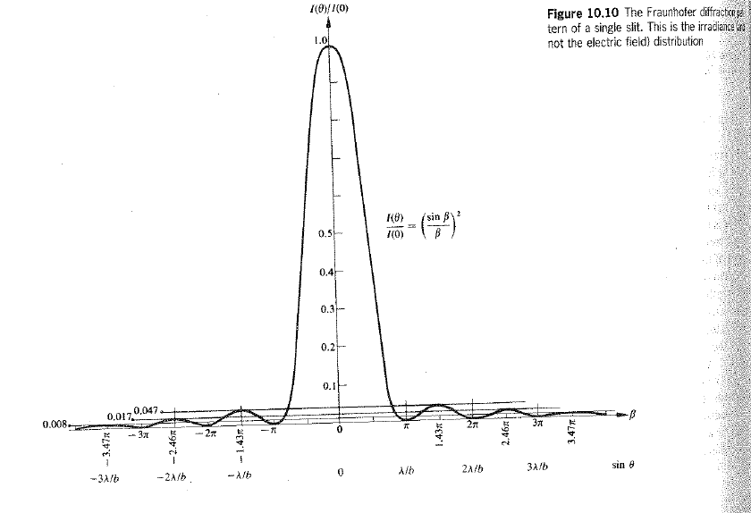

Slide 6
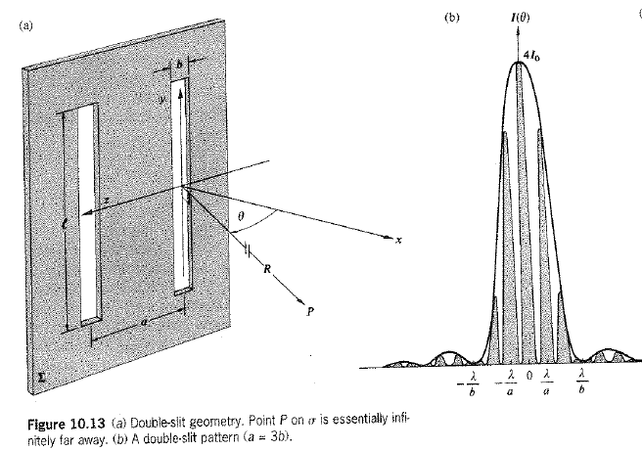

Slide 7
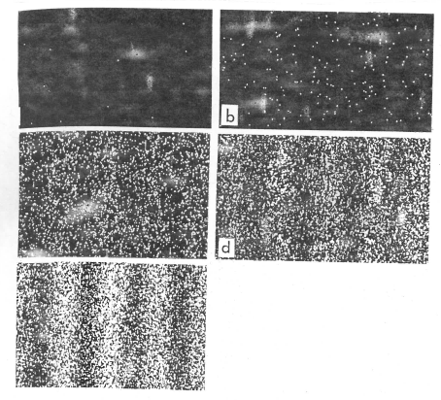
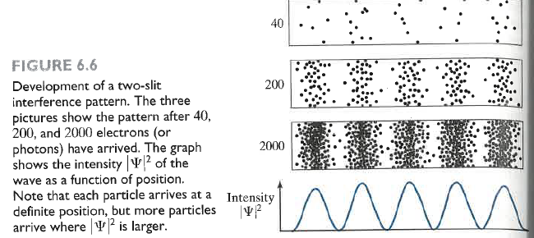
So much for interference phenomena in light waves – now:
It happens to particle waves too!
How to account for this? The square of a
new quantity, the wave fct, that is unique
to QM determines the probability of finding
the e- on the screen as fct of position.
ψ
The unfamiliar new letter is “psi”, a Greek
letter reserved for the wave fct.
Double slit experiment with
e⁻ , exposure increases left
to right and top to bottom.

Slide 8
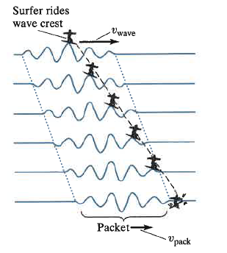
But first: do you know your wave stuff?
Waves move the medium that carries them:
At any given point in the water, as a wave moves by,
the water bops up and down. - this follows the laws of
periodic motion, like a pendulum.
… and waves can move through the medium
bringing the wave to shore.
This opens up a different kind of motion, wave
motion proper – it can happen only at one velocity,
the wave velocity v = λ * f
But that’s only the fundamental case when you have only one wave.
In QM we will need more waves at the same time in the same spot
to create what is known as Standing Waves, an illusion to the eye
that occurs when several waves bump back and forth between
boundaries (ends of the medium).
n/b the hydrogen atom will provide the boundary conditions for our e- which will be like a standing wave inside the atom.

Slide 9
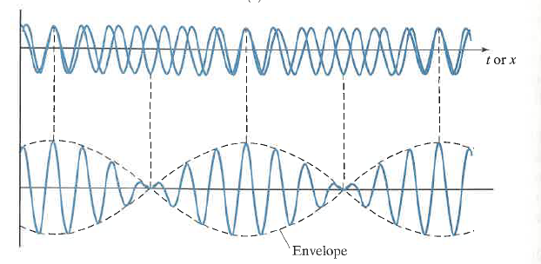
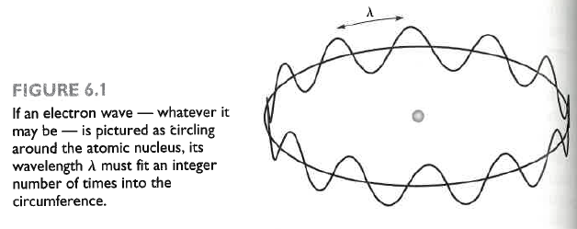
What are Standing Waves again?
Two or more traveling waves
meet in a medium that is confined
between two boundaries.
Their amplitudes add and a pattern
results (the envelope) whose nodes
and anti-nodes (maxima and zeroes)
do not move over time, although
its amplitude swells and diminishes.
In the Bohr model of the
hydrogen atom, the e-
forms a standing wave
around the nucleus.

Slide 10
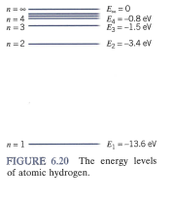
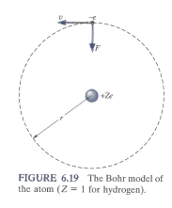
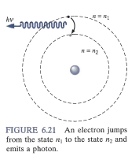

Slide 11
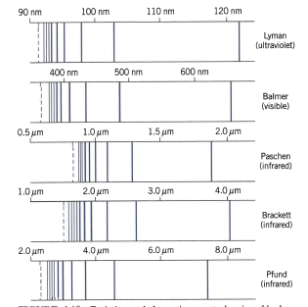
Visible Evidence: hydrogen photons
Extensive optical data confirm
that the e- in hydrogen exists in such
Special Standing Wave states.
Not all orbits lead to Standing Waves.
quantization is a good match
for this observation.

Slide 12
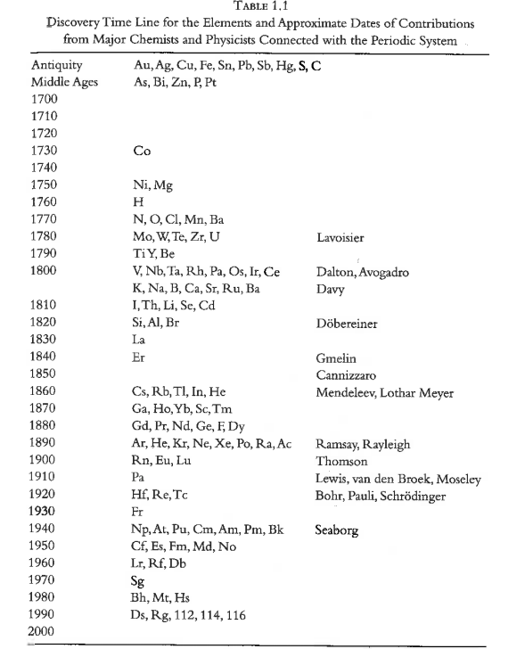
Atomic Physics - Bohr Model
Discovery of the elements.

Slide 13
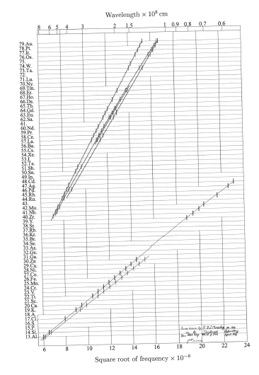
X-ray spectra are another
confirmation of quantized
orbits.
Moseley’s Plot: SQRT(f)
for x-ray radiation of elements

Slide 14
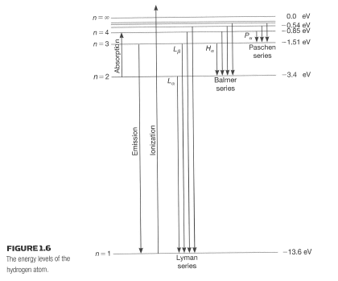
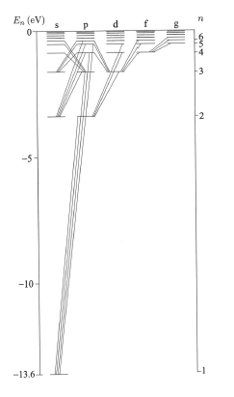
Allowed transitions in hydrogen

Slide 15
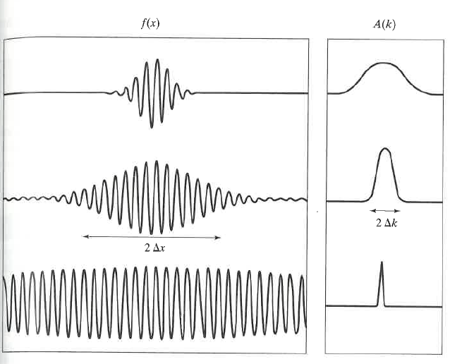
The relevance of this for atoms lies in the de Broglie wave picture of particles:
the matter waves.
Several traveling waves combine into a Standing Wave known as a wave packet
This results in language that describes
the location of a particle in terms
of wave language.
Particles can be “localized” in a variety of
ways, but their constituent traveling waves
are still everywhere.
“Position” is described in terms of an
Uncertainty Relation because the wave packet is not just in one location.
The sharply defined distribution of traveling waves (bottom right) that make the wave
packet (bottom left) leads to a broad “location” of the particle. Lasers are light
analogues of such cases. Their “coherence” stretches far out in space, for some
Lasers over about a mile.

Slide 16
Psi is the fct for which we have to solve DEQ with boundary conditions.
Different boundary conditions represent different physical situations, known as “wells”.
Ultimately, what as we aspire to is finding the correct well that describes the hydrogen atom, in hopes that this will make a good starting point to understand the wells for all atoms.
We will follow a number of improving but unsuccessful attempts to discover how this works. If we would just introduce what actually works it would be cryptic and impossible to follow why it works. However, the wells we study “on the way” fortunately do have purpose and meaning in other situations which we/the book does not anticipate yet, for example nuclear wells.

Slide 17
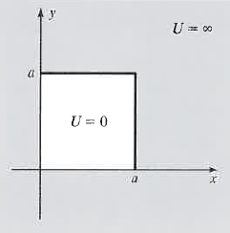
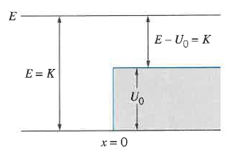
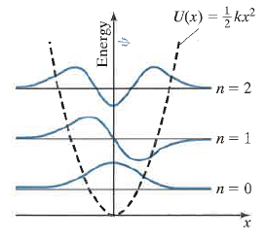
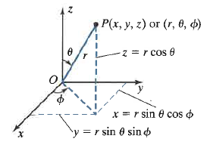
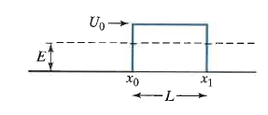
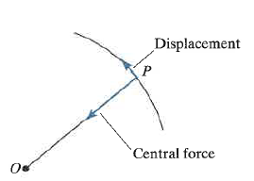
The standard wells are:
An infinitely deep one-dimensional square well
A finite square well,
An infinite two-dimensional square well,
A harmonic oscillator well,
A step function well,
An infinite three-dimensional square well,
A two-/three- dim central force well.
And we will consider a free particle.
All of these are described in “energy space” (the vertical axis).
You can think of it as energy maps that express how much energy it costs to go from A to B on the horizontal axis.
The equation of motion is known as the Schroedinger equation. It is a second
order DEQ that can be solved stationary or as function of time. It is a time and
location dependent function of Psi. The solutions will always be appropriate
combinations of exponential or sine/cos functions.

Slide 18
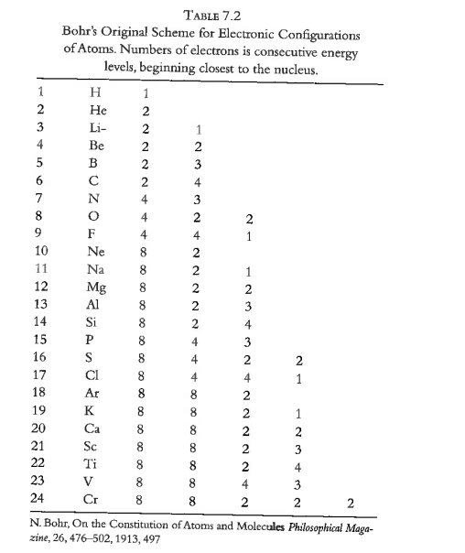
Bringing order to the chaos of elements:
Early quantum number approach.

Slide 19
Introduction to Quantum Mechanics

Slide 22
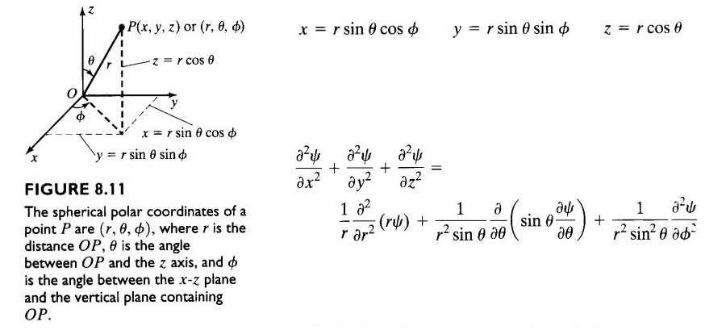
Quantum Physics - Hydrogen

Slide 23
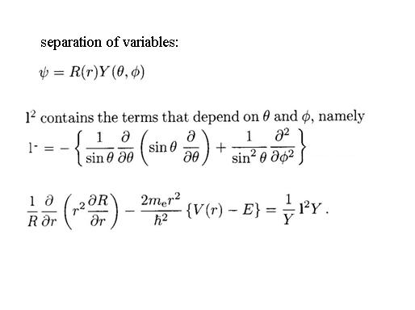
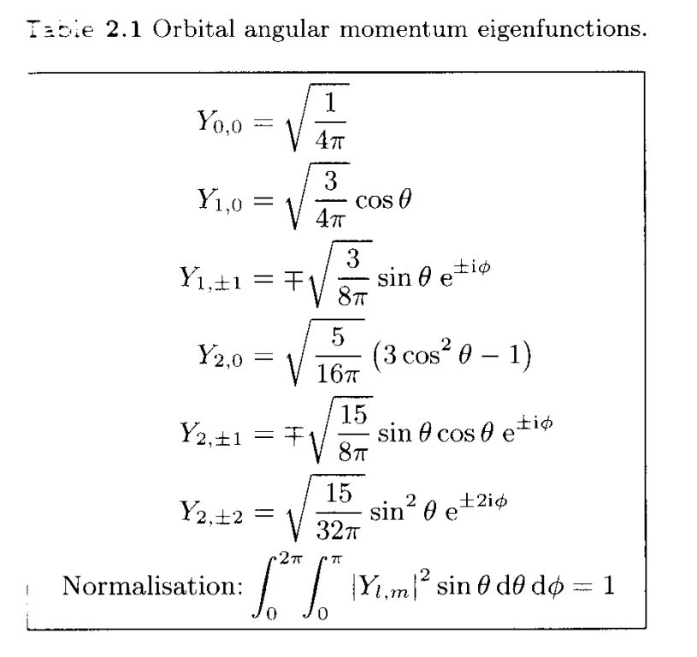
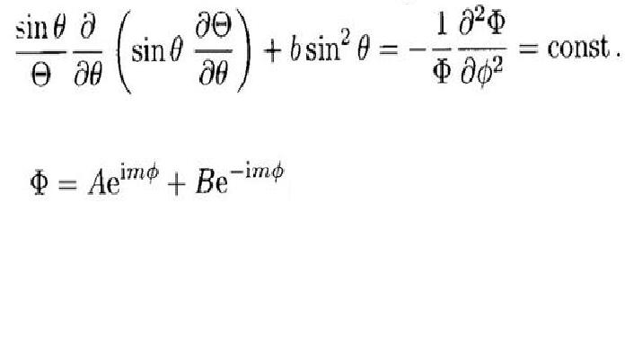
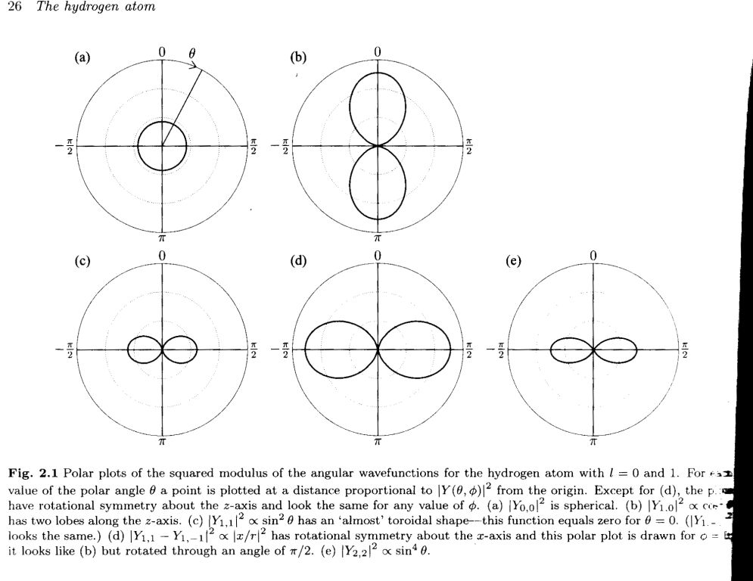
S-Eqn
solve
Θ:
Solve for first angle:

Slide 24
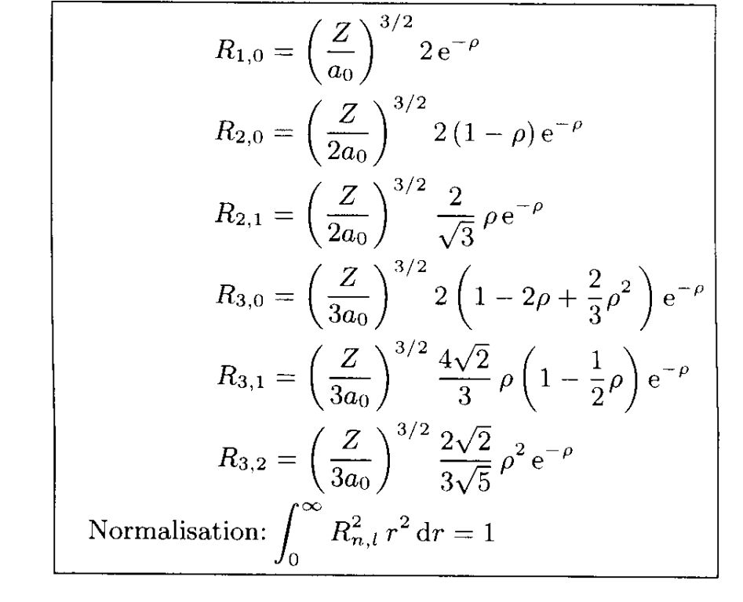
Radial solution functions:

Slide 25
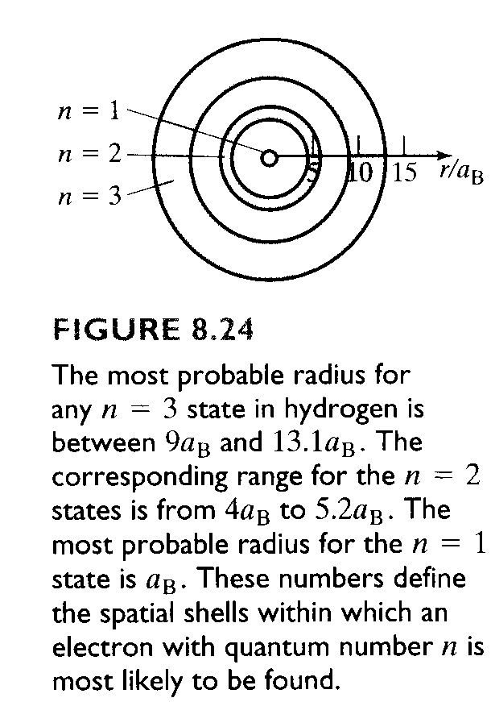
“Shells”

Slide 26
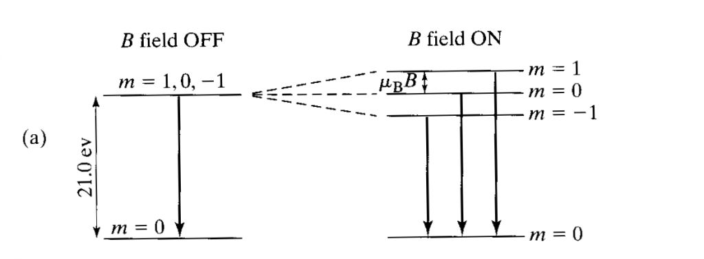
Magnetic q-number: Zeeman Effect

Slide 27
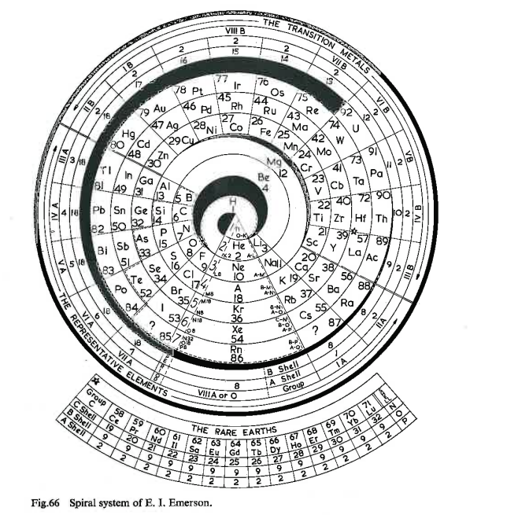
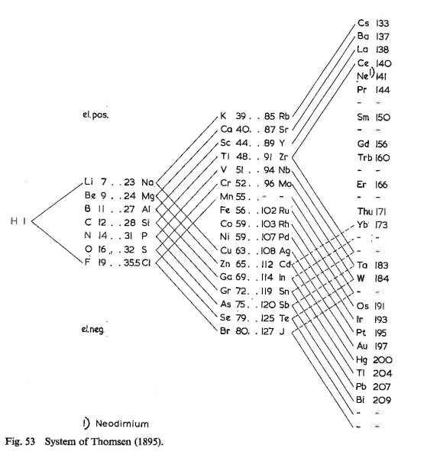
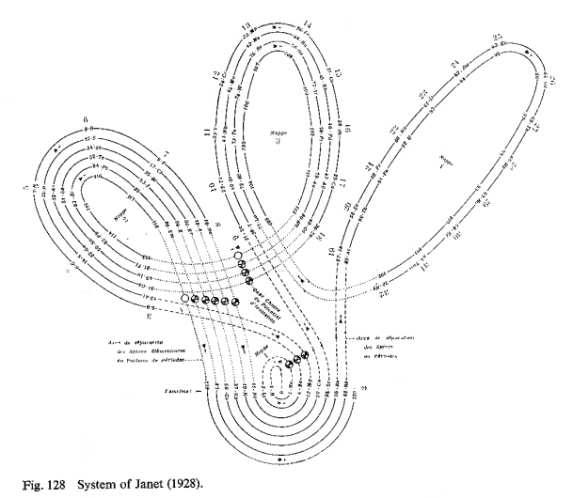
Early Attempts at Periodic Table

Slide 28
The Missing Piece:
Pauli Exclusion Principle

Slide 29
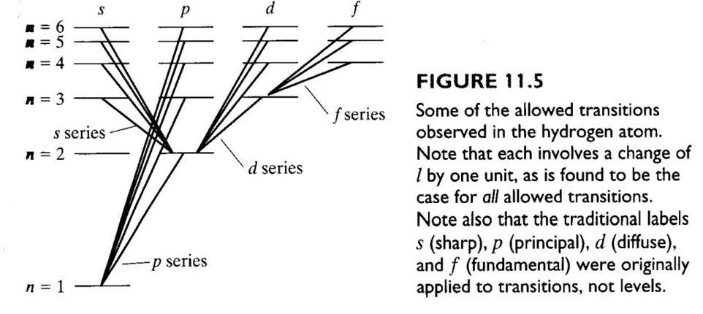
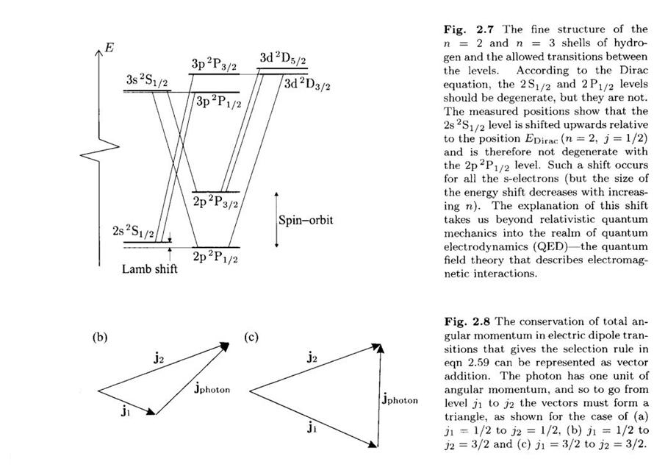
Selection Rules & Forbidden Transitions

Slide 30
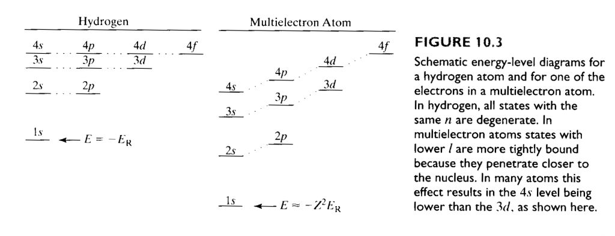
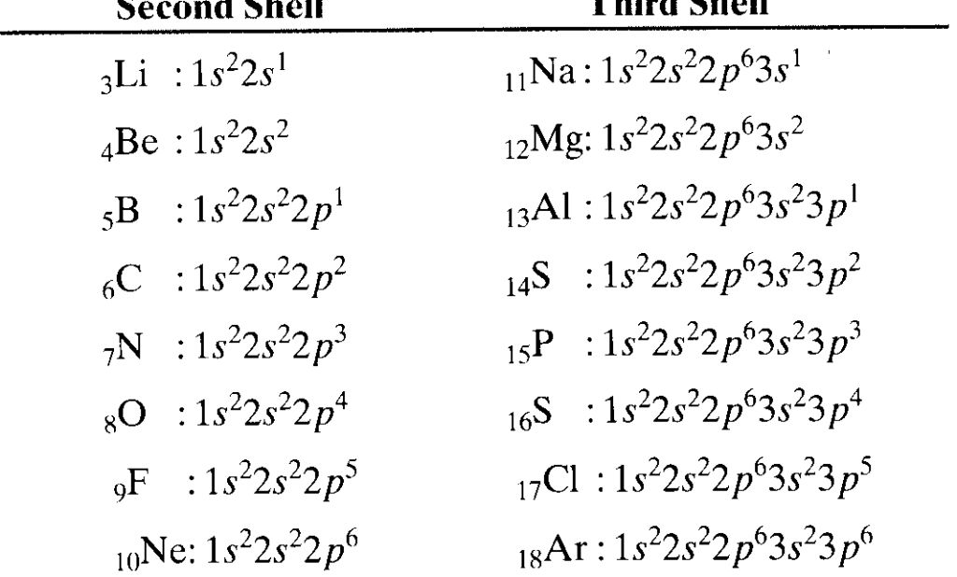
Periodic Table

Slide 31
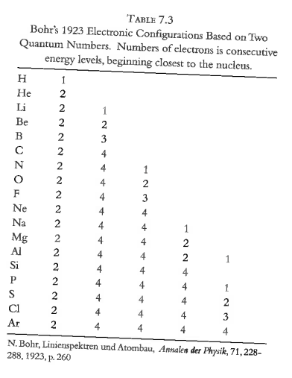

Slide 32
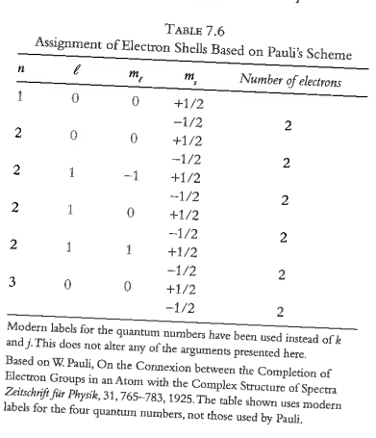
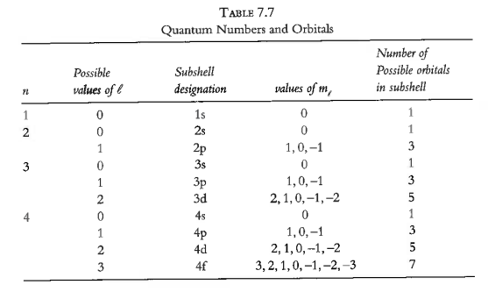

Slide 33
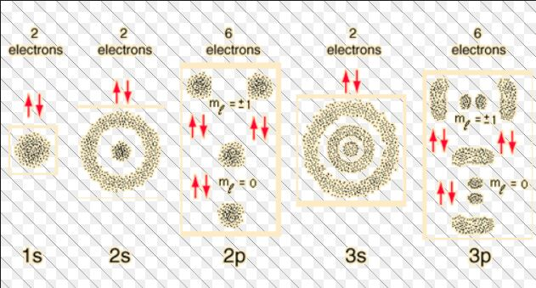
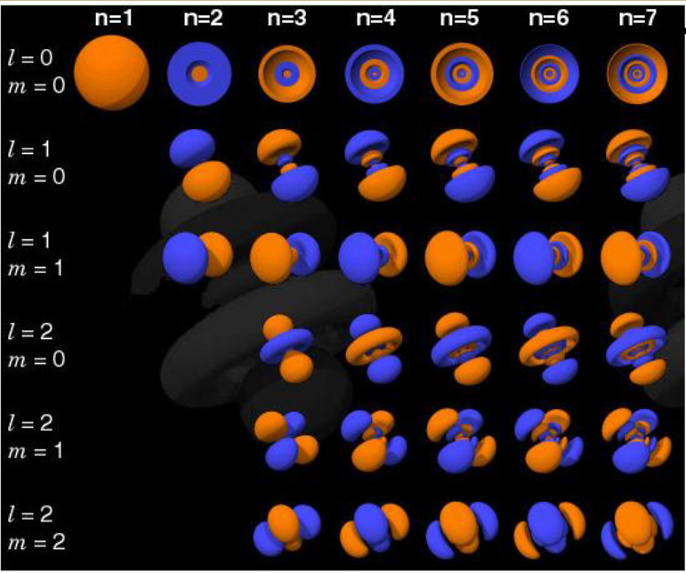
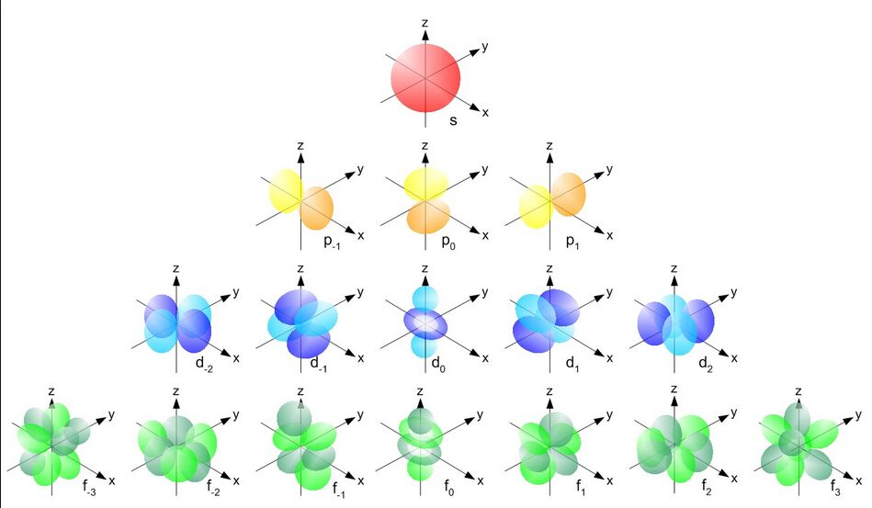

Slide 34
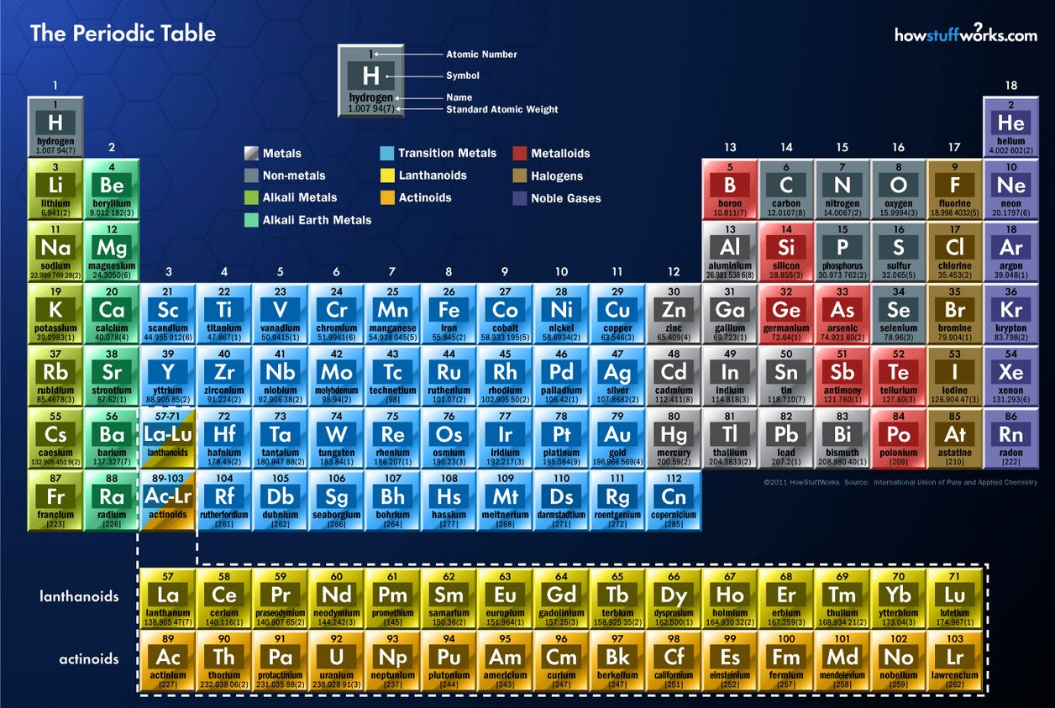
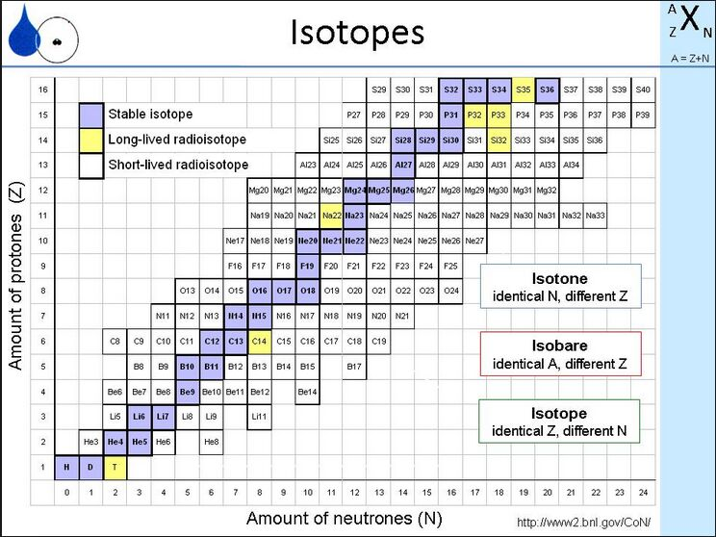

Slide 35
